Slide 1


Social Buzz

Slide 2

fdfd
Social Buzz is a fast growing technology unicorn that need to adapt quickly to it's global scale.
Accenture has begun a 3 month POC focusing on these tasks:
An audit of Social Buzz's big data practice
Recommendations for a successful IPO
Analysis to find Social Buzz's top 5 most popular categories of content
Project Recap

Slide 3



Problem
Want to complete the IPO
Not enough resources to manage the scale
Want to learn from big corps
Social Buzz has reached a massive scale within recent years and does not have the resources internally to handle it.

Slide 4
1
Data Exploring
Process
2
Data Cleaning
3
Data modeling
4
Data Analysis
5
Uncover Insights

Slide 5

Insights
Number of categories
Most popular content type
Month with most posts
16
Photo
May 2021

Slide 6
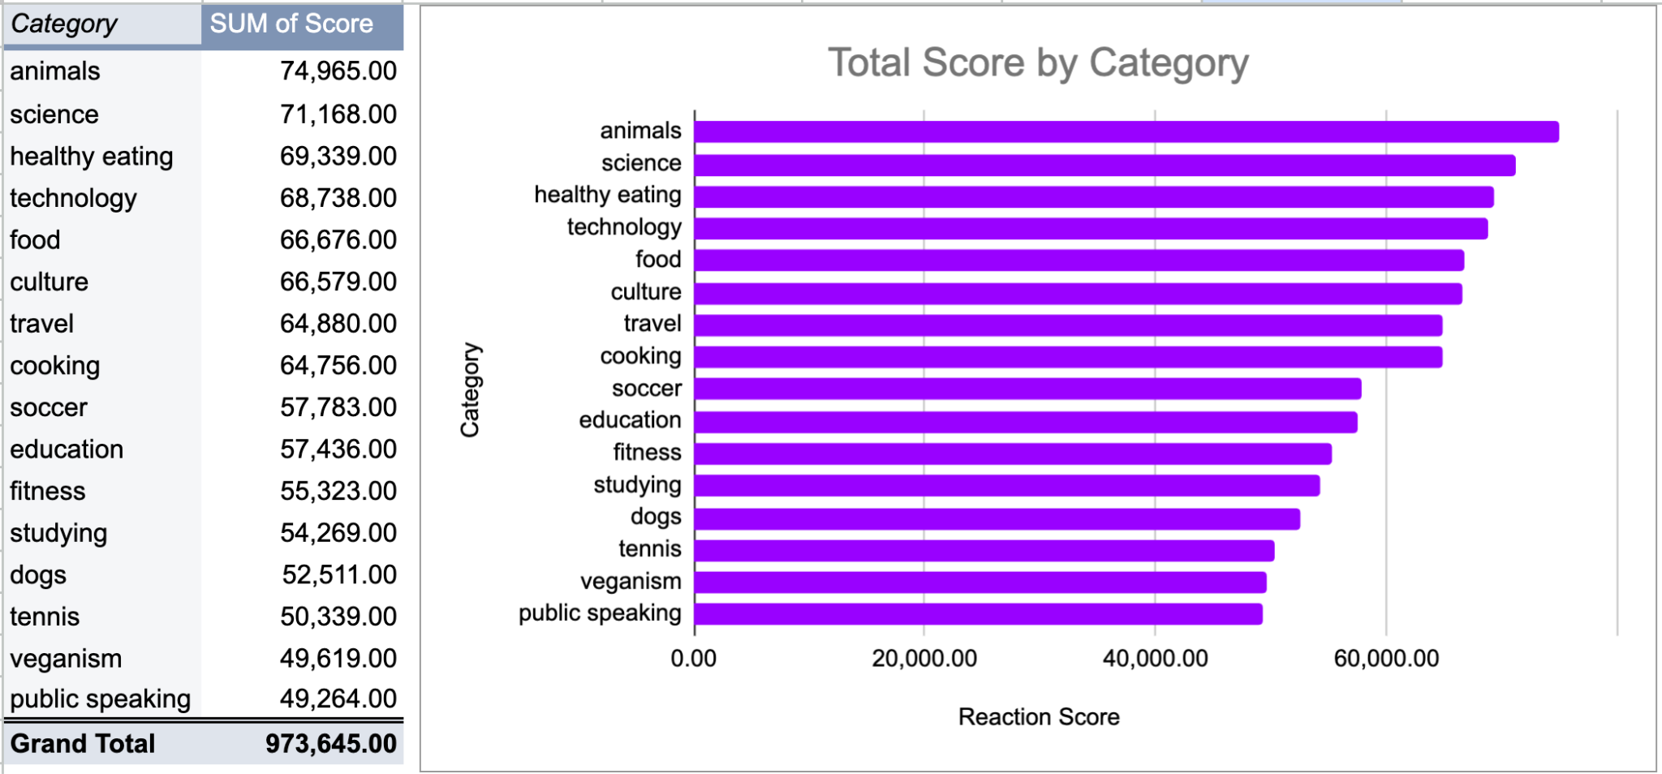

Slide 7
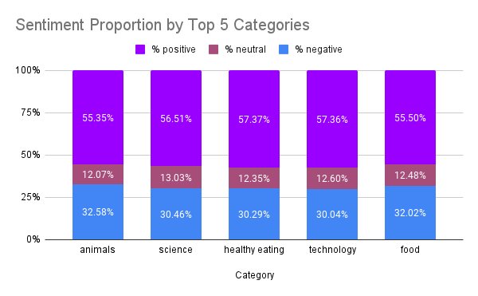
The total score aligns closely with the total number of reactions per category.
Minor differences exist in the number of reaction sentiments across each category.
The sentiment distribution for each category is estimated at 55-57% positive, 11-13% neutral, and 30-33% negative.

Slide 8
Summary
ANALYSIS
INSIGHT
NEXT STEPS
Summary
Animals and science are the two most popular categories of content, showing that people enjoy "real-life" and "factual" content the most.
Food is a common theme with the top 5 categories with "Healthy Eating" ranking the highest. This may give an indication to the audience within your user base. You could use this insight to create a campaign and work with healthy eating brands to boost user engagement.
This ad-hoc analysis is insightful, but it's time to take this analysis into large scale production for real-time understanding of your business. We can show you how to do this.

